Slide 1
PART II
SYSTEMS DEVELOPMENT TOOLS

Slide 2
Modelling
Modeling produces a graphical representation of a concept or process that systems developers can analyze, test, and modify.
A systems analyst can describe and simplify an information system by using a set of business, data, object, network, and process models.

Slide 3
Modelling
A business model, or requirements model, describes the information that a system must provide.
A data model describes data structures and design.
An object model describes objects, which combine data and processes.
A network model describes the design and protocols of telecommunications links.
A process model describes the logic that programmers use to write code modules.

Slide 4
Prototyping
Prototyping tests system concepts and provides an opportunity to examine input, output, and user interfaces before final decisions are made.
A prototype is an early working version of an information system.
A prototype can serve as an initial model that is used as a benchmark to evaluate the finished system, or the prototype itself can develop into the final version of the system.

Slide 5
CASE tools
Computer-aided systems engineering (CASE), also called computer-aided software engineering, is a technique that uses powerful software, called CASE tools, to help systems analysts develop and maintain information systems.

Slide 6
Systems Development Method
Structured Analysis
Object Oriented Analysis
Agile/Adaptive Methods

Slide 7
Structured Analysis
Description
Represents systems in terms of data and the processes act upon that data, SDLC waterfall model
Modelling Tools
Data Flow Diagram (DFD)
Pros
Well suited to project management
Cons
Users might not be able to describe their needs until they can see example

Slide 8
Structured Analysis
Structured analysis is a traditional systems development technique that is time-teste and easy to understand. Structured analysis uses a series of phases, called the systems development life cycle (SDLC), to plan, analyze, design, implement, and support an information system.
Structured analysis is based on an overall plan, similar to a blueprint for constructing a building, so it is called a predictive approach.

Slide 9
Object Oriented Analysis
Description
Views the systems in terms of object, uses waterfall model
Modelling Tools
Use case model
Pros
Easy to maintain and expand
Cons
Interaction of objects and classes can be complex in larger system

Slide 10
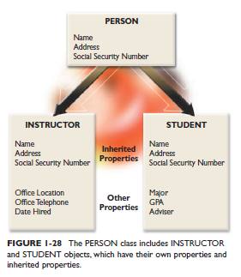
Object Oriented Analysis

Slide 11
Agile Methods
Description
Team based effort, uses spiral model
Modelling
Collaborative software, brain storming and whiteboards
Pros
Flexible and efficient in dealing with change
Cons
Team members need a high level of technical skills
Overall project might be subject to scope change as user requirements change.

Slide 12
Agile Methods
Agile methods, in contrast, attempt to develop a system incrementally, by building a series of prototypes and constantly adjusting them to user requirements.
As the agile process continues, developers revise, extend, and merge earlier versions into the final product.
An agile approach emphasizes continuous feedback, and each incremental step is affected by what was learned in the prior steps.
Determines the end process instead of objectives

Slide 13
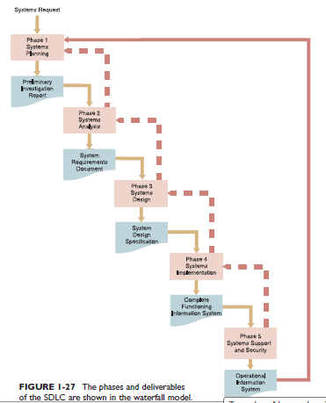
Waterfall Model
Phase 1: Systems Planning
Preliminary investigation report
Phase 2: Systems Analysis
System requirements document
Phase 3: Systems Design
System design specification
Phase 4: Systems Implementation
Complete functioning information system
Phase 5: Systems Support and
Security
Operational information system

Slide 14
Systems Planning Phase
System request new information system or upgrading of an existing system
Feasibility Study
Anticipates costs and benefit analysis, operational, technical, economical and time factors

Slide 15
Systems Analysis
Logical model of the new system
Interview, surveys, document reviews, observation and sampling

Slide 16
System Design
Physical model that will satisfy all documented requirements for the system
User interface
Identify necessary outputs, inputs and processes
Systems reliability, accuracy, maintainability and security

Slide 17
Systems Implementation
Programs are written, tested and documented and the system is installed
Systems evaluation

Slide 18
System Support and Security
Maintains, enhance and protect systems
A well-designed system must be secure, reliable, maintainable, and scalable.
A scalable design can expand to meet new business requirements and volumes.

Slide 19
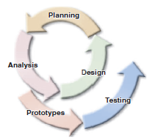
SDLC – interactive model
Planning
Analysis
Design
Prototypes
Testing

Slide 20
SDLC - Spiral Model
Spiral models initially were suggested in the 1990s by Barry Boehm, a noted software engineering professor.
He stated that each iteration, or phase, of the model must have a specific goal that is accepted, rejected, or changed by the user, or client.
Thus, each iteration produces feedback and enhancements, which enable the team to reach the overall project goal.

Slide 21
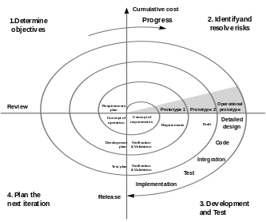
SDLC – Spiral Model
Define objectives,
constraints and deliverables
Identify risks and develop
acceptable resolutions
Develop a prototype that
includes all deliverables
Perform assessment and
testing to develop objectives
for next iteration

Slide 22
Other development methods
Joint Application Development
focuses on team-based fact-finding
Rapid Application Development
compressed version of the entire process.
Both JAD and RAD use teams composed of users, managers, and IT staff.

Slide 23
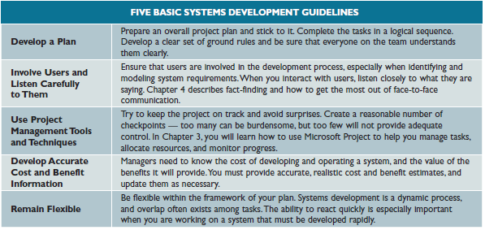
Systems Development Basic Guidelines

Slide 24
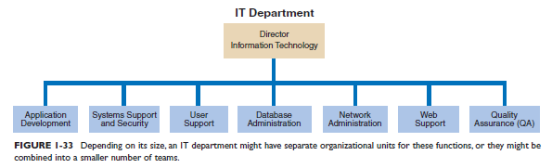
IT department

Slide 25
IT department
The IT application development group typically provides leadership and overall guidance
Systems support and security provides vital protection and maintenance services for system hardware and software
User support provides users with technical information, training, and productivity support also called as help desk.
Database administration involves data design, management, security, backup, and access.

Slide 26
IT Department
Network administration includes hardware and software maintenance, support, and security.
Web support specialists design and construct Web pages, monitor traffic, manage hardware and software, and link Web-based applications to the company’s information systems.
Many large IT departments also use a quality assurance (QA) team that reviews and tests all applications and systems changes to verify specifications and software quality standards.

Slide 27
System Analysts
A systems analyst investigates, analyzes, designs, develops, installs, evaluates, and maintains a company’s information systems.
Analysts help translate business requirements into IT projects.
Document business profiles, review business processes, select hardware and software packages, design information systems, train users, and plan e-commerce Web sites.

Slide 28
System Analysts
A successful systems analyst needs technical knowledge, oral and written communication skills, an understanding of business operations, and critical thinking skills.

Slide 29
END

